Slide 1

Local Food Wastage Management System
Hello, everyone. My name is Sampurna Sharma, and today I'm going to present my project titled “Local Food Wastage Management System”, which I built as part of the GUVI Data Science course.

Slide 2
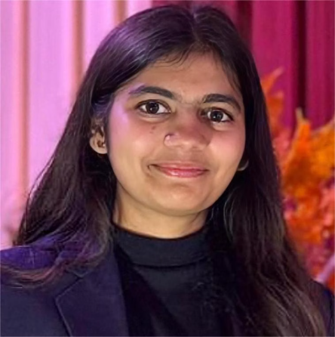

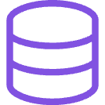
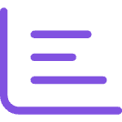

Meet the Creator
I'm a Computer Science graduate from Faridabad, specializing in Python, SQL, and data visualization. This project was my first independent venture with Streamlit, challenging me to build a complete data-driven system from problem understanding to interactive dashboards.
Python Proficiency
SQL & Databases
Leveraging Python for robust data cleaning and manipulation.
Expertise in PostgreSQL for efficient data storage and retrieval.
Data Visualization
Social Impact
Creating compelling dashboards with Matplotlib, Seaborn, and Plotly.
Driven by a passion to build solutions that create real social change.

Slide 3

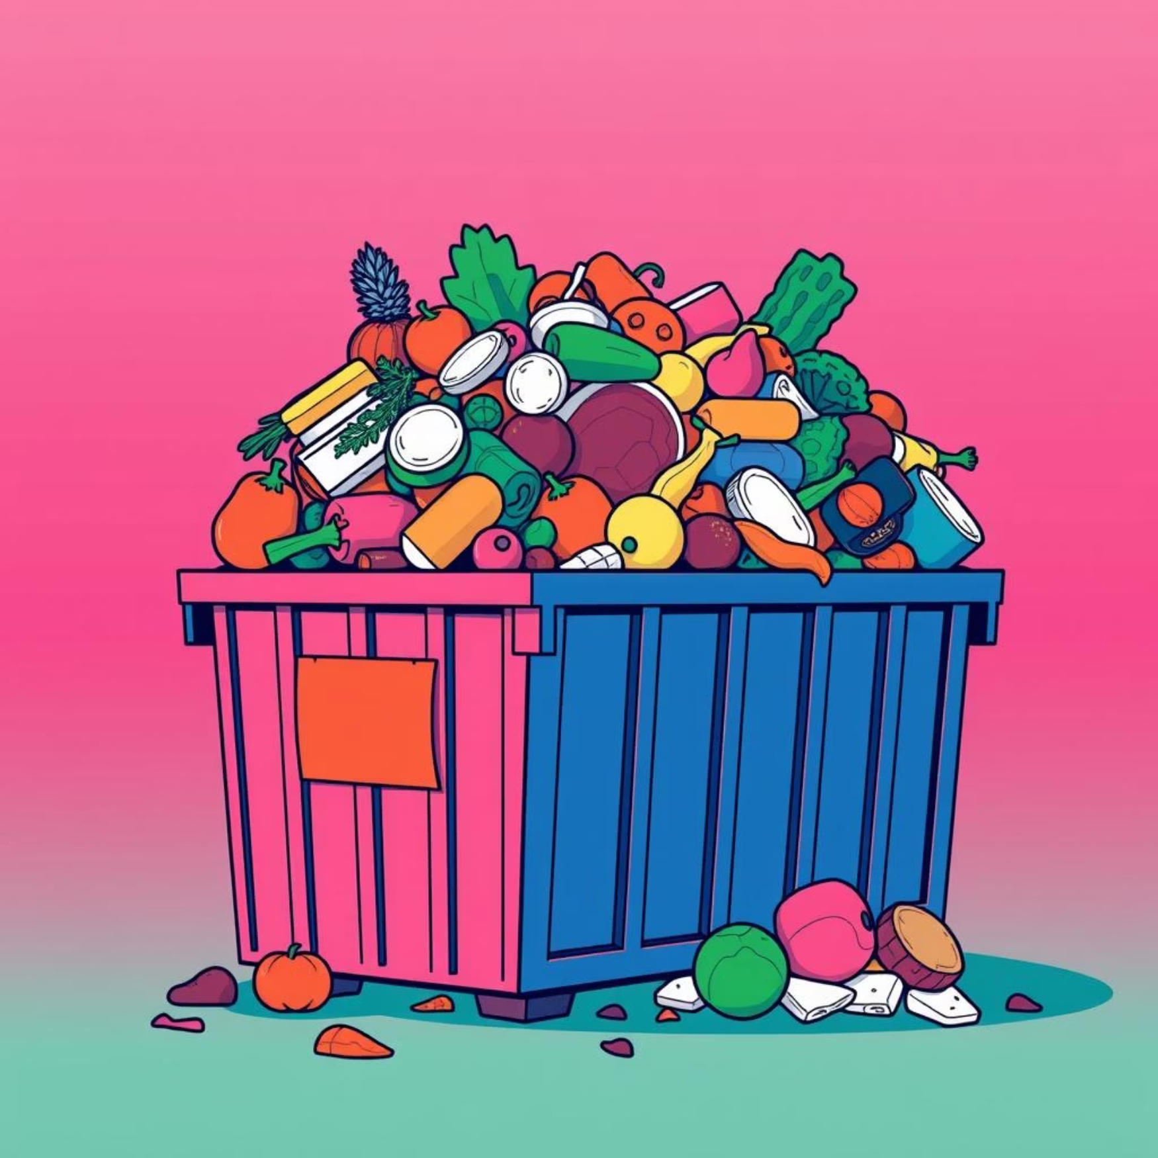
The Problem: Food Waste & Hunger
Globally, a third of all food produced is wasted, while millions face hunger. Restaurants and stores discard edible food daily, even as NGOs and individuals struggle to access it. This disparity highlights a critical need for efficient distribution.
Surplus Food Discarded
Communities in Need
Restaurants and stores frequently discard excess food that is still perfectly edible, contributing to significant waste.
Meanwhile, many NGOs and individuals struggle to access sufficient food, creating a stark contrast with the amount of food being wasted.

Slide 4



Our Solution: Connecting Providers & Receivers
Our system aims to minimize food wastage by intelligently connecting surplus food providers with verified receivers, leveraging data analytics for smarter, faster distribution.
Providers List Food
Receivers Claim Food
Track & Analyze
Restaurants, stores, and individuals can easily list their surplus edible food items.
Verified NGOs and community centers can view available food and claim items in real-time.
Admins and analysts monitor donation patterns through data queries and interactive dashboards.

Slide 5

Tools & Technologies Utilized
To build this end-to-end analytics solution, I employed a comprehensive stack of tools, from backend data management to interactive frontend visualization.
1
2
Python & Pandas
PostgreSQL & SQL
Used for efficient data cleaning, transformation, and manipulation, ensuring data quality.
A robust relational database for structured data storage, with 15+ SQL queries for deep insights.
3
4
Streamlit
Matplotlib, Seaborn & Plotly
Developed an intuitive, interactive web dashboard for user engagement and data exploration.
Integrated for creating rich, informative, and interactive data visualizations.

Slide 6
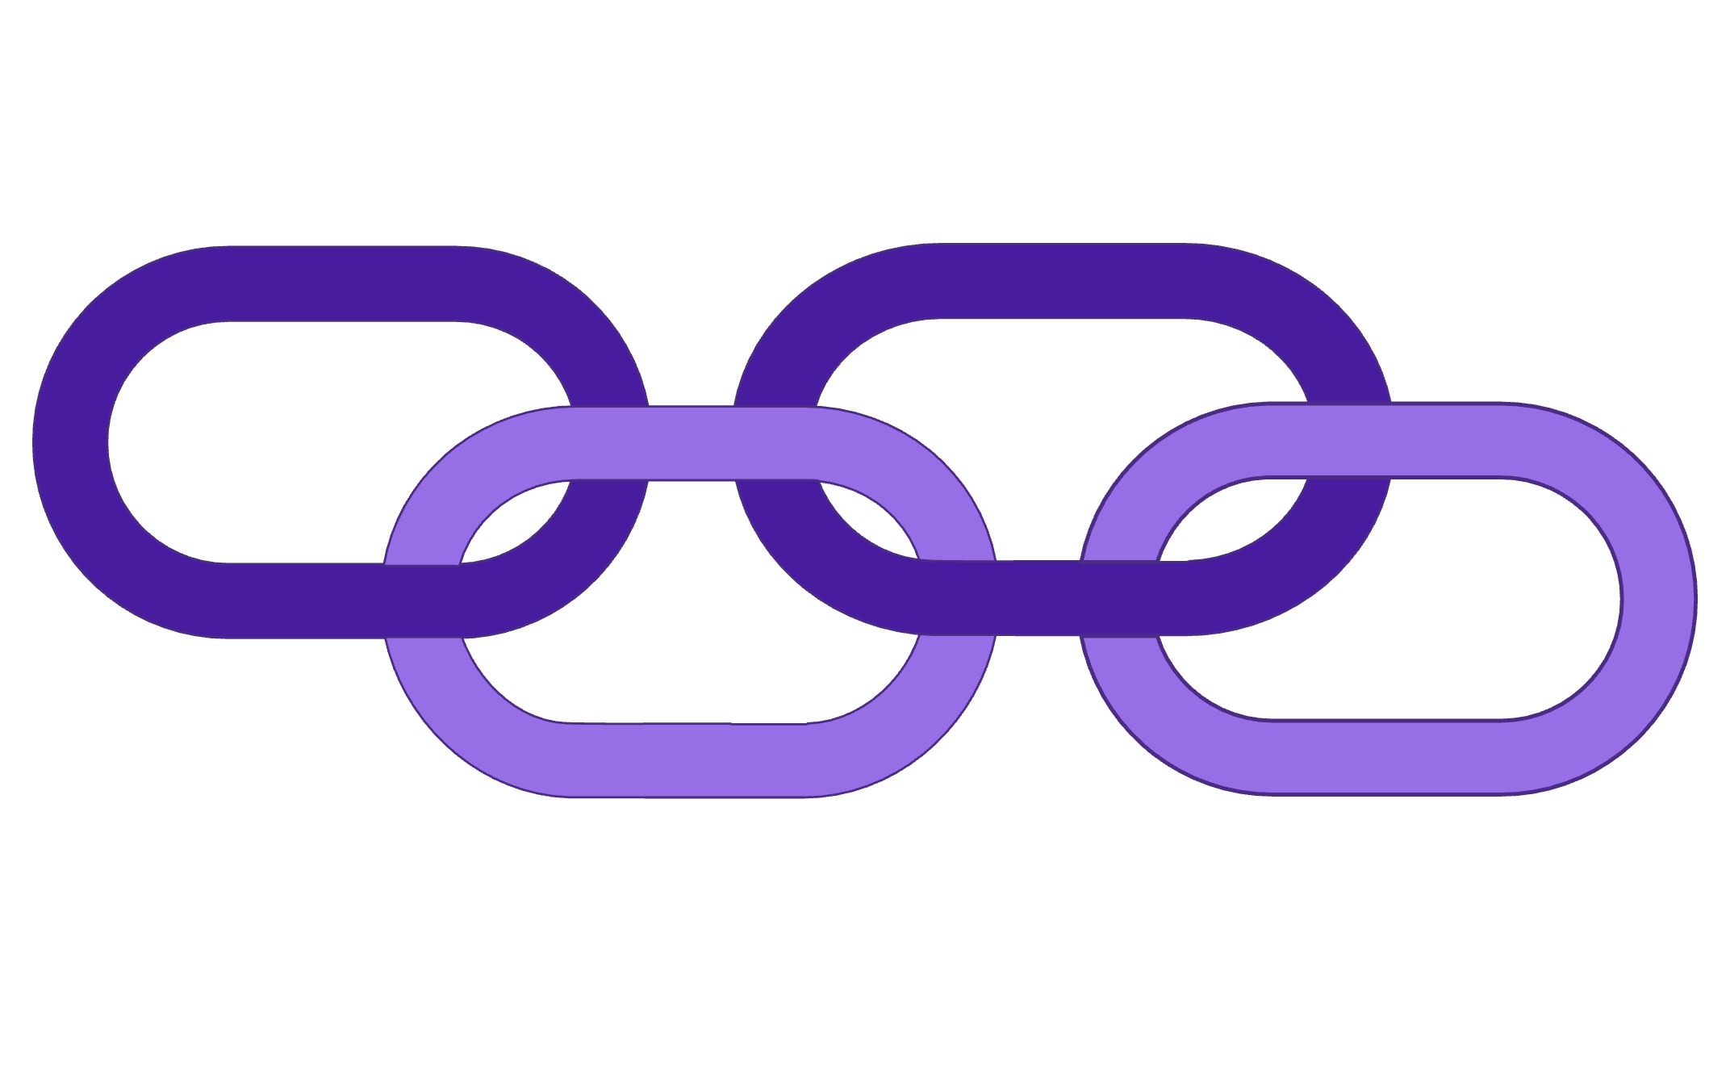
Robust Database Design
The system's foundation is a relational database in PostgreSQL, structured for scalability and data integrity. It features key tables interconnected by primary and foreign keys.
Providers Table
Receivers Table
Food Listings
Claims Table
Providers: Details of restaurants, stores, and individual donors.
Receivers: Information on NGOs, community centers, and individuals in need.
Food Listings: Contains food name, type, quantity, and expiry date.
Claims: Tracks food items claimed by receivers, including timestamps.

Slide 7

SQL Queries & Insights
Over 15 structured SQL queries were executed to uncover patterns in food donation, providing actionable insights for decision-making and optimizing distribution.
Donations per City: Identify high-contributing urban areas.
Monthly Donation Trends: Track changes in donation quantities over time.
Top 10 Donated Items: Pinpoint frequently available food types.
Receiver-wise Distribution: Analyze food allocation among various recipients.
Claims by Category: Understand demand patterns for different food types.
Waste Hotspots: Identify locations or food types with high potential for waste.
These queries revealed crucial information, such as which locations donate the most, common wasted food items, and how claim volumes fluctuate seasonally.

Slide 8
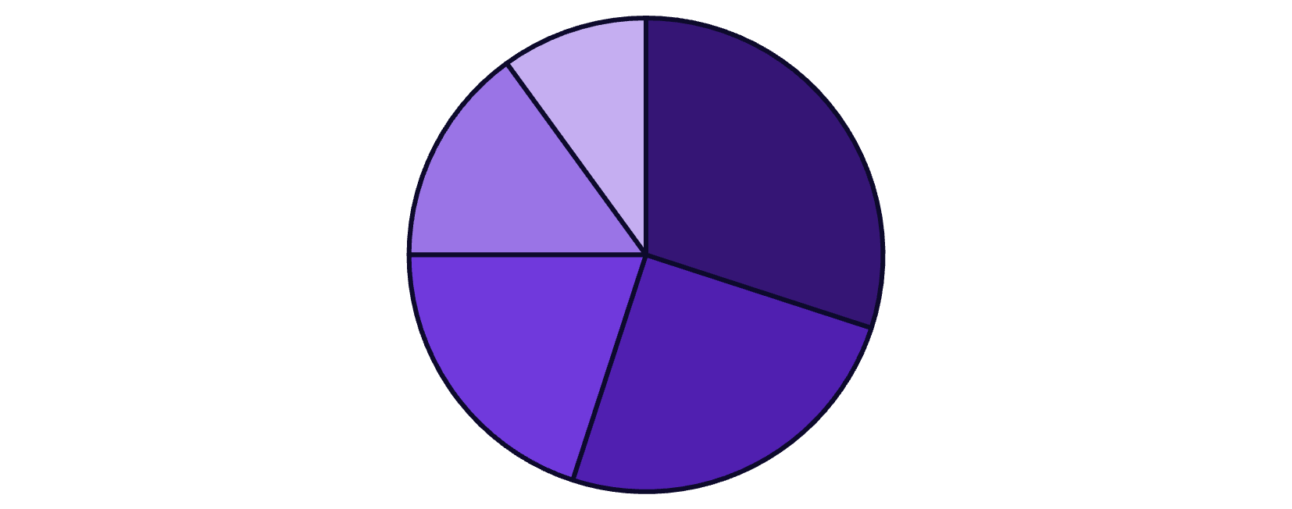
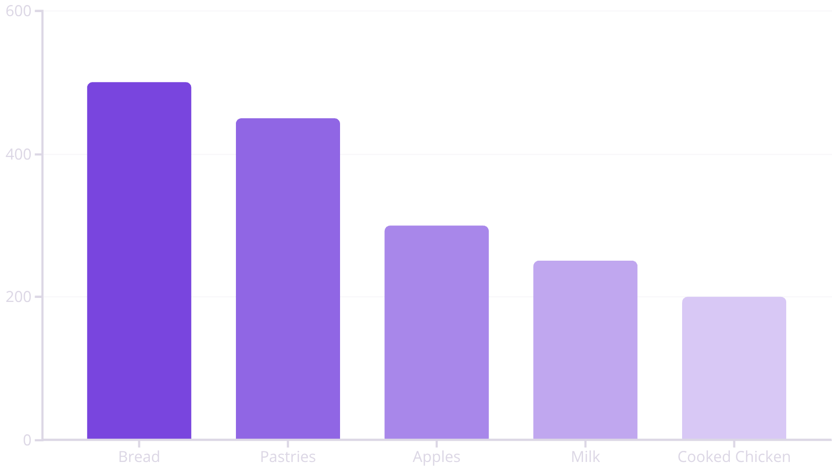
Transforming Data with Visualizations
Complex data is made digestible through a variety of interactive visualizations, all seamlessly integrated into the Streamlit dashboard for easy user exploration.
Baked Goods
Fruits & Veggies
Prepared Meals
Dairy & Meat
Canned Goods
Pie charts effectively break down food categories by volume, showing the largest contributions from baked goods and fresh produce.
Bar graphs highlight the most frequently donated food items, with bread and pastries leading the list.

Slide 9
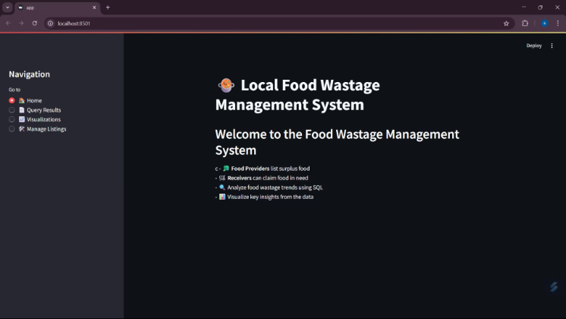
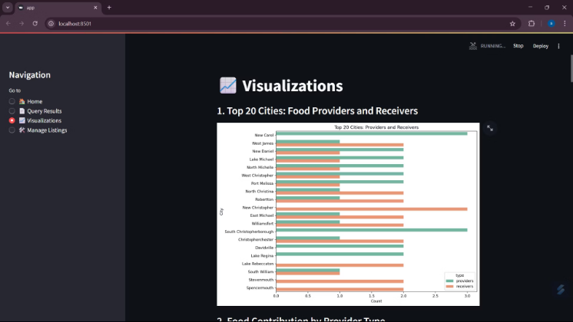
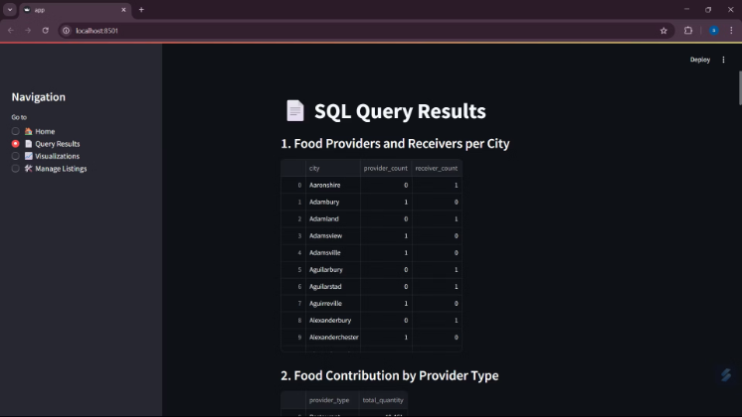
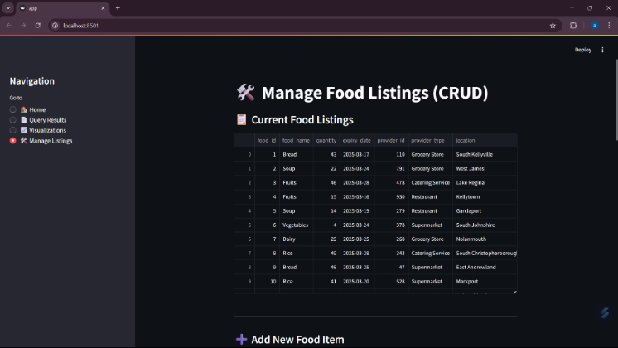
The Streamlit Web Application
The Streamlit app is the interactive core of this project, offering a user-friendly interface for managing data, viewing analytics, and streamlining food distribution workflows.
Informative Homepage
Query Results & Dashboards
CRUD Operations
Provides a clear overview of the project's mission and functionalities.
Enables seamless addition, editing, and deletion of food listings, provider/receiver data, and claims.
Dedicated tabs for dynamic query results, interactive tables, and insightful visualizations.

Slide 10




Impact & Future Potential
This system offers significant benefits, from reducing food waste to empowering NGOs, and reinforces the power of data-driven solutions for social good.
Transparency
1
Data-driven food distribution
NGO Empowerment
2
Real-time food access
Waste Reduction
3
Minimize urban food waste
Social Good
4
Technology for community impact
This project has enhanced my skills in databases, dashboard development, and end-to-end system creation, paving the way for future impactful solutions.

Slide 11






Challenges I Faced
Learning Streamlit from scratch
Navigating a new framework required hands-on practice and continuous experimentation.
Writing optimized SQL queries
Ensuring efficiency for large datasets demanded careful query structuring and indexing.
Cleaning inconsistent data
Transforming raw, varied data into a usable format was a meticulous and time-consuming process.
Linking backend to dashboard smoothly
Integrating the PostgreSQL database with the Streamlit frontend required robust connection handling.

Slide 12

Conclusion
This project was a transformative experience, solidifying my skills and reinforcing my commitment to leveraging technology for social good.
End-to-End Project Building
Confidence in Data & Storytelling
Tech for Social Good
I gained hands-on experience in every phase, from database design and SQL querying to interactive dashboard development.
This journey significantly boosted my proficiency with various data tools and my ability to extract and present compelling insights.
The system's potential for real-world impact deepened my sense of responsibility towards using technology for community benefit.

